Slide 1








Overview Chapter 7
P= RT/V
Ideal Gas Equation of State
Van der Waals Equation of State
Cubic Equation of State
Virial Equation of State
Peng-Robinson Equation of State (PREOS)
Cubic Equation of State
Solve cubic equations (3 roots)

Slide 2

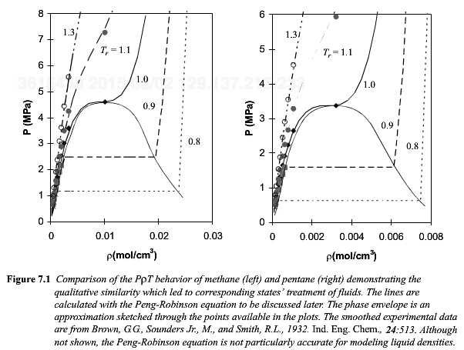

Slide 3
SCF
CL
V
L
L/V
IG
0.95<Z<1.05

Slide 4
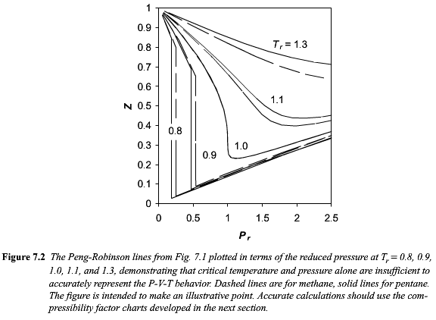


Slide 5
Arrhenius Behavior
P_{sat} ~ exp(-E_{a}/kT)
Log(P) ~ 1/T
Slope is an activation energy for P_{sat}

Slide 6
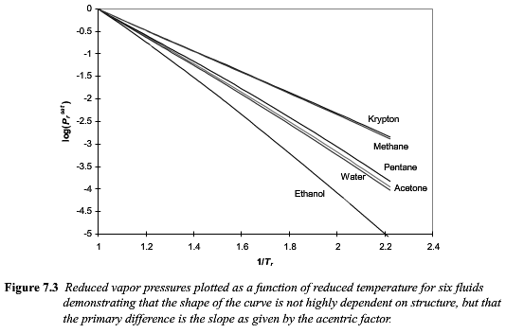

1/0.7 = 1.43
-1 for Helium

Slide 7
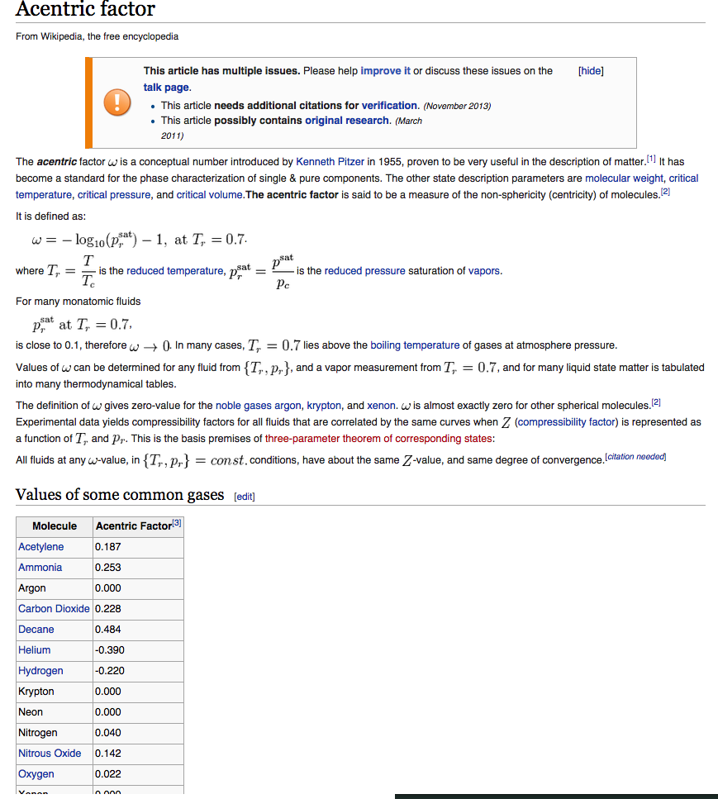

Slide 8
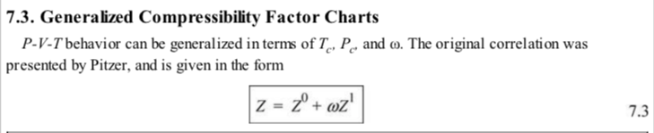

Slide 9
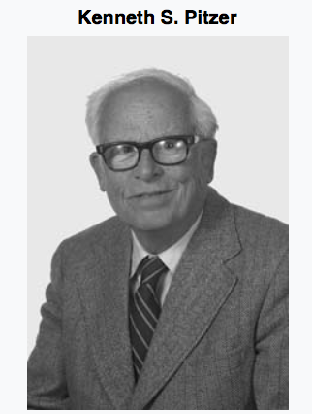
CalTech
Berkley
Rice
Stanford

Slide 10
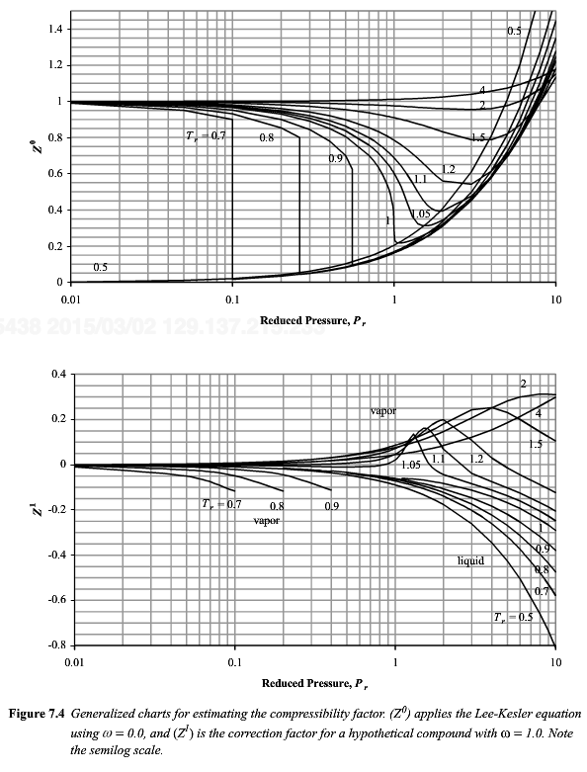

Slide 11
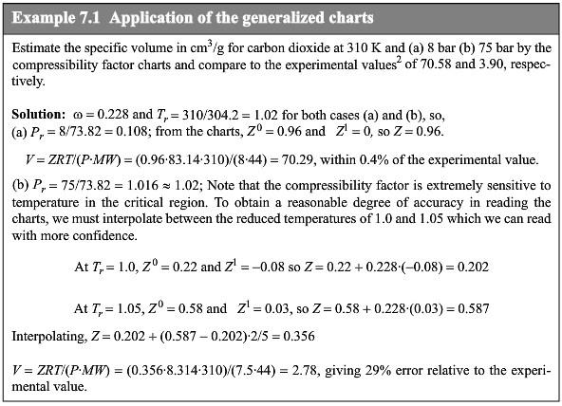

Slide 12
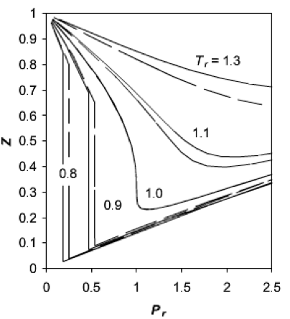
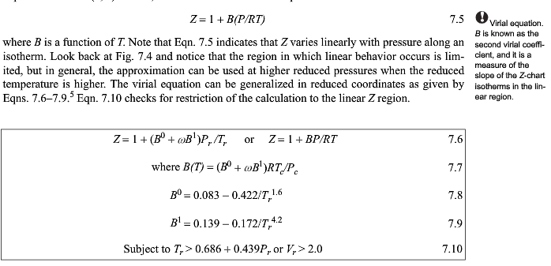
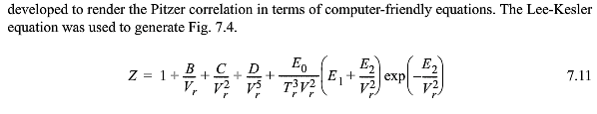

Slide 13

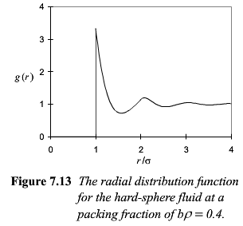
Why Virial Expansion?
1) In situations where you want simple derivatives of P, V or Z in density.
Density fluctuations can be observed at zero angle scattering (light, neutrons, X-rays) as the inverse of the isothermal compressibility, κ_{T} = -1/V (dV/dP)_{T}, so the first derivative of P as a function of ρ, which is B₂(T), can be easily measured. This can also be measured in an osmotic pressure measurement using a semipermeable membrane.
2) B₂(T) can be calculated from an integral of the potential energy u(r) between atoms/particles, from quantum or molecular or coarse grain theory.
3) B₂(T) can be calculated from the radial distribution function, from simulations and measurements.

Slide 14
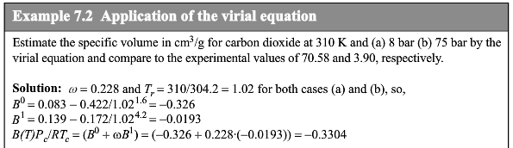
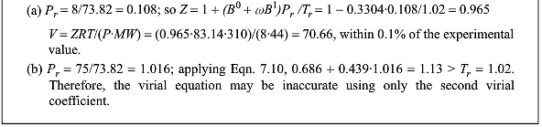

Slide 15



No acentric factor

Slide 16
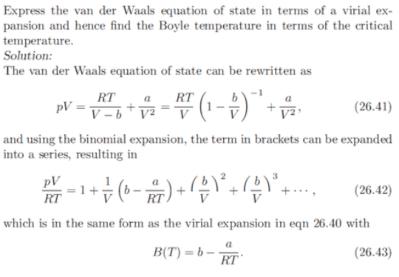
From Concepts in Thermal Physics

Slide 17
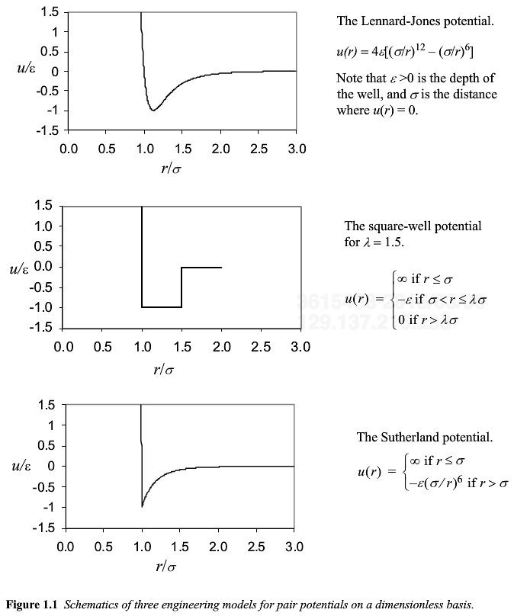

Slide 18

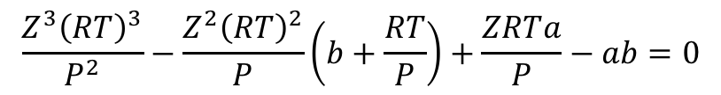
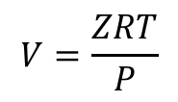
Van der Waals Equation as a Cubic EOS
$$V^{3}P−V^{2}\left(bP+RT\right)+Va−ab=0$$
$$V=\frac{ZRT}{P}$$
$$\frac{Z^{3}{\left(RT\right)}^{3}}{P^{2}}−\frac{Z^{2}{\left(RT\right)}^{2}}{P}\left(b+\frac{RT}{P}\right)+\frac{ZRTa}{P}−ab=0$$

Slide 19

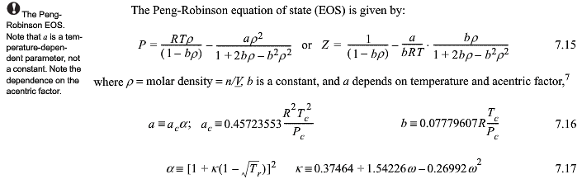


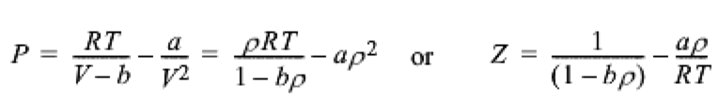

Slide 20
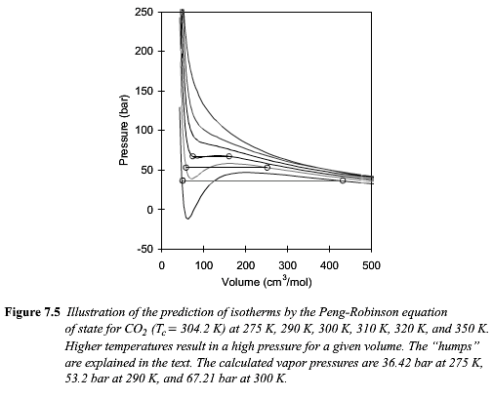
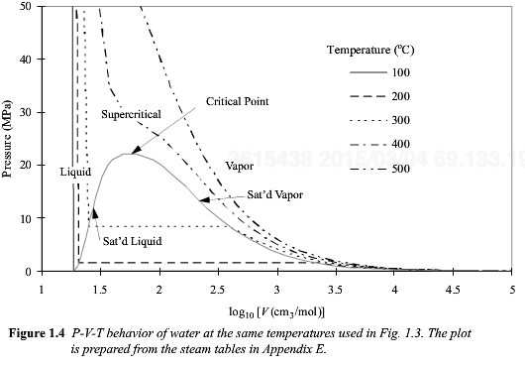

Slide 21
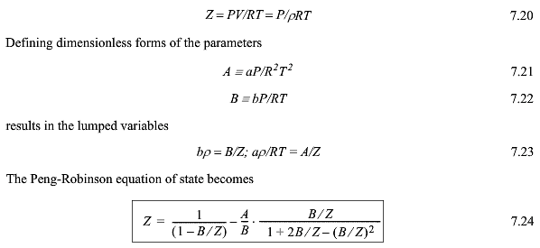

Dimensionless form for equations of state

Slide 23
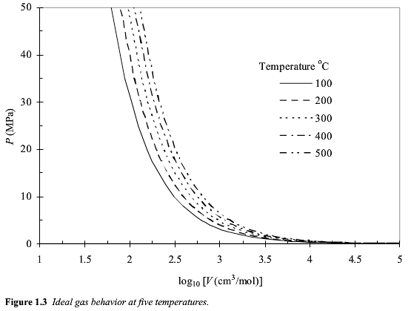

Slide 24
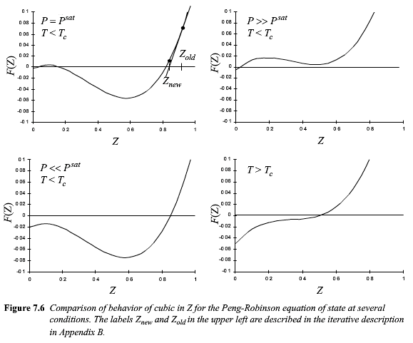
F(Z)=

Slide 25
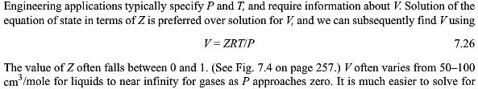


Slide 26
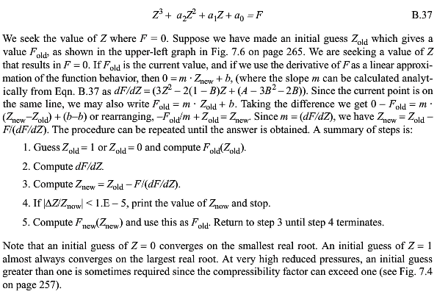

Slide 27
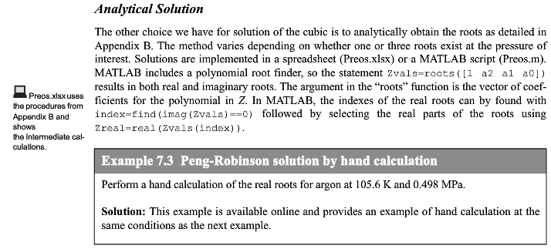
http://chethermo.net/sites/default/files/doc/supp/SuppExcel.pdf

Slide 28
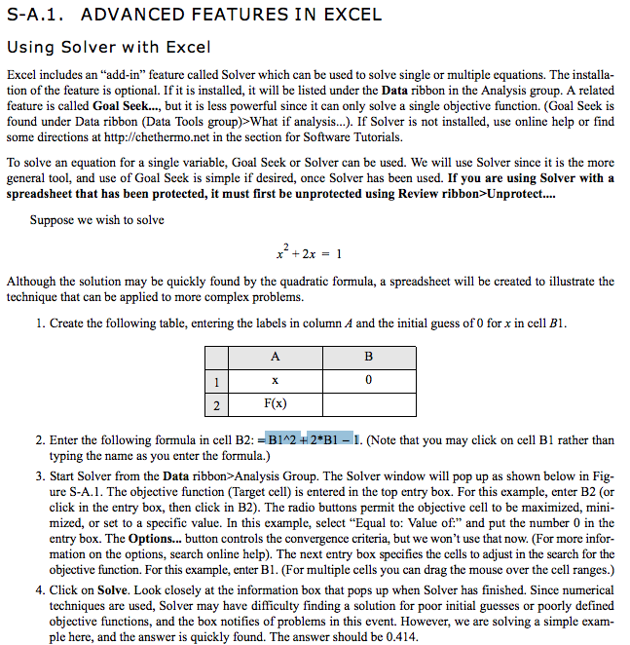

Slide 29
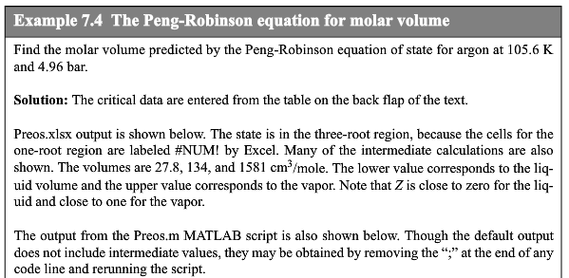
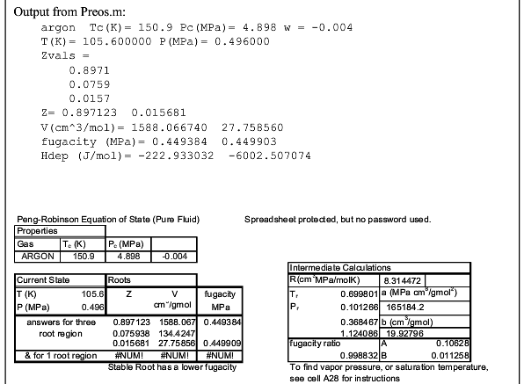

Slide 30
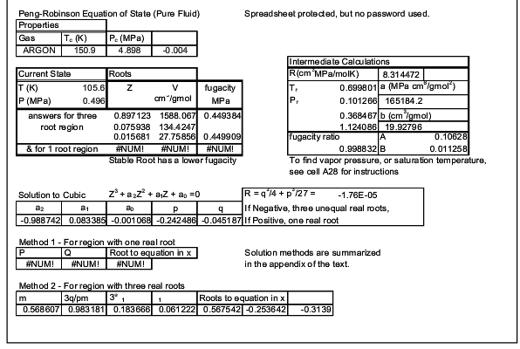

Slide 31
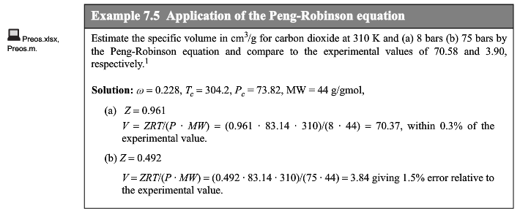

Slide 32
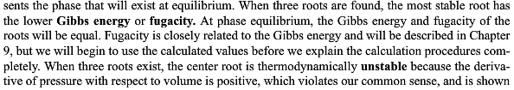
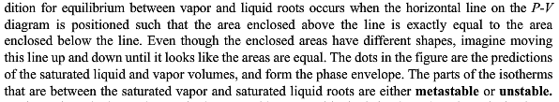

Slide 33
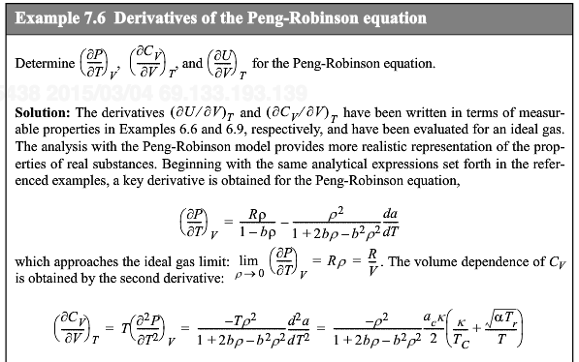




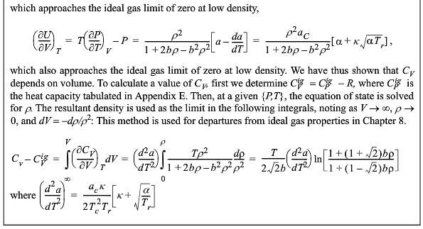

Slide 34
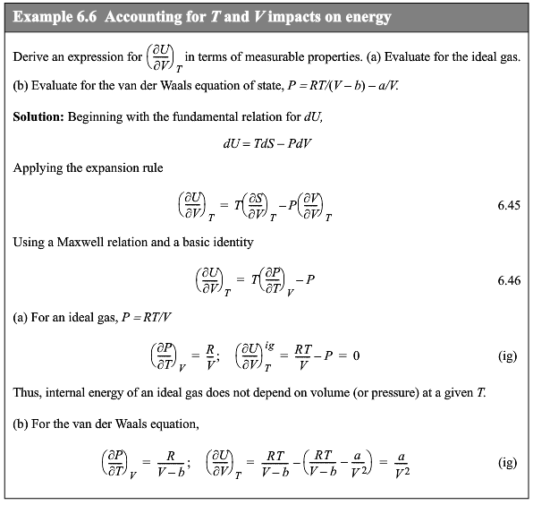
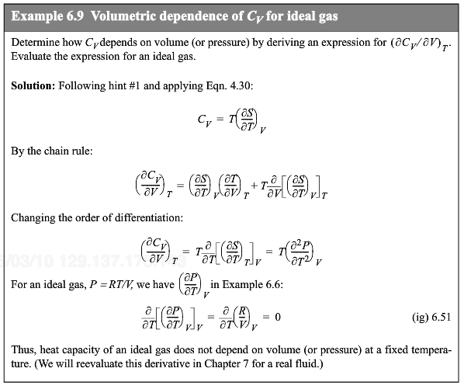

Slide 35

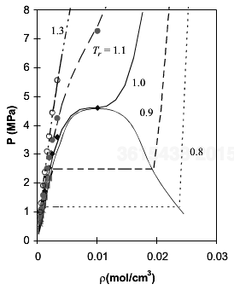
Solve for a and b
in Van der Waals
Eqn. for instance

Slide 36

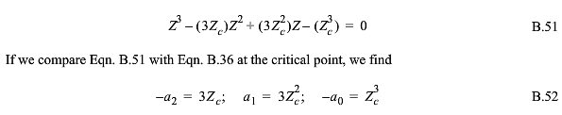
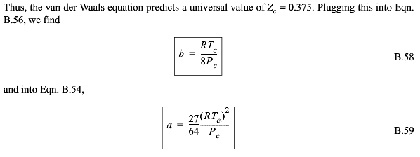
This is solved in appendix B2 p. 822

Slide 37
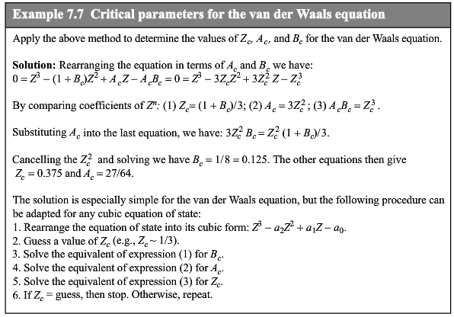

Slide 38

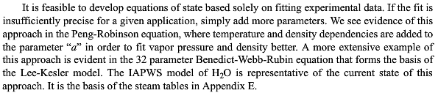


Slide 39
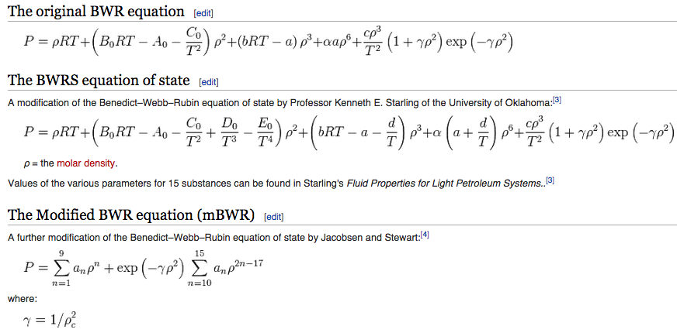

Slide 41


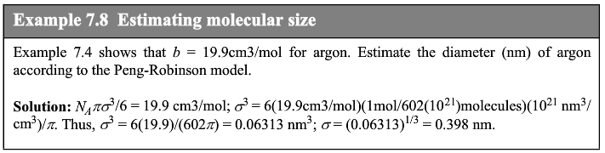
How do molecular parameters relate to EOS
e.g. VDW EOS
VDW EOS
PR EOS
Molar volume and b
Packing factor (0 to 1) η_{P} = ρb = b/V
VDW EOS
So, a/b is attractive energy in J/mole
a/b = N_{A} ε

Slide 42

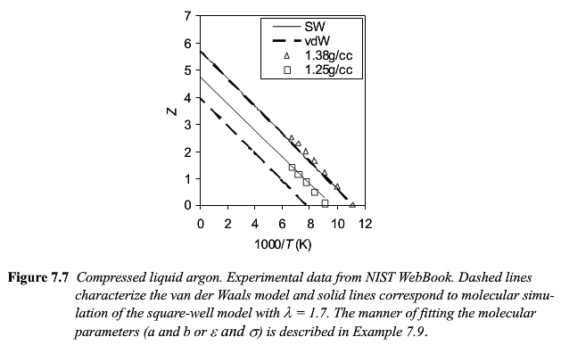
Slope in 1/T Due to
Attractive Interactions
Repulsive Interactions

Slide 43
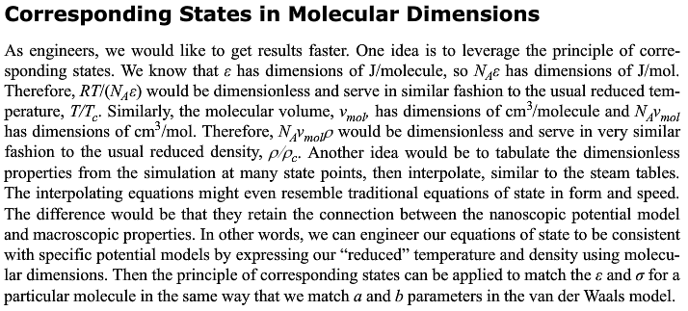

Slide 44
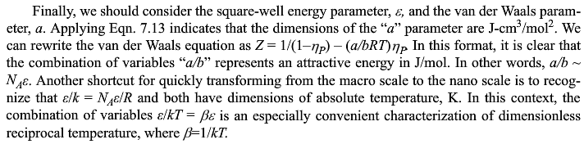

Slide 45
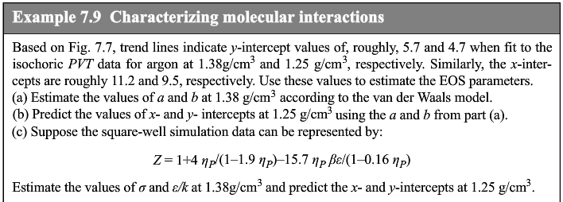


Slide 46


Molecular Simulations for EOS
Collision of two particles in 2D

Slide 47



Slide 48



Slide 49



Slide 50







Slide 51




Slide 52





Slide 54


Slide 56



